Slide 1
Shortcuts from an Impatient DBA
Andy Mallon

Slide 2
Andy Mallon
Working with SQL Server since SQL 2000
Background in Tech Support
Managed databases in many industries
Lazy
Impatient
Healthcare
Finance
E-Commerce
Non-profit
Andy@am2.co
linkedin.com/in/AMtwo
www.ImpatientDba.com
www.am2.co
@AMtwo

Slide 3
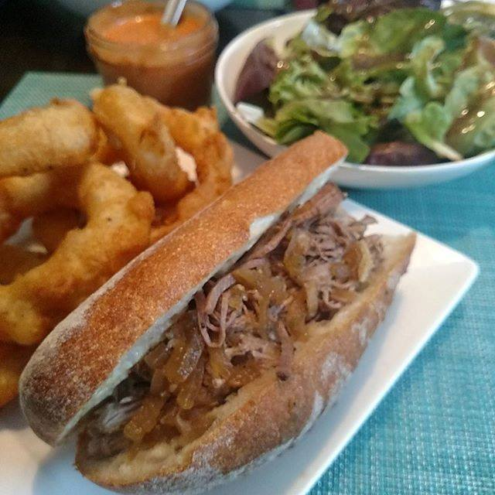
Notes:
Some of the things I love most in life– My husband, my pups, my food (I love to cook), and my city.

Slide 4
SSMS Keyboard shortcuts
(the ones you probably already know)
Ctrl+Tab/Ctrl+Shift+Tab – Switch tabs
Ctrl+R – Show/hide Results pane
Ctrl+L – Get estimated execution plan
Ctrl+M – Include actual execution plan
Ctrl+ (K,C) – Comment selected text
Ctrl+ (K,U) – Uncomment selected text
Shift+Alt+Enter – Toggle full screen
Ctrl+U – Move cursor to database-selection dropdown
Notes:
Some keyboard shortcuts that have been blogged to death. There are plenty of details out there about these—I don’t think they’re as interesting, and there’s not a lot for me to teach about these.

Slide 5
More SSMS Keyboard shortcuts
(the ones you might not know)
(the cool ones)
(I think they’re cool)
(hopefully you do too)
Notes:
I want to talk about some of the shortcuts that you might not know about. They’re the ones that when I saw them the first time, I thought “damn, that’s cool.”

Slide 6
CTRL + SHIFT + V
Clipboard ring
Pasting the less-than-most-recent thing
Never lose something that only existed on your clipboard
Last 15 clipboard entries
Notes:
How often have you pasted pasted something, and the clipboard had something completely different than you thought?
“OOPS. When did I copy something else to my clipboard?”

Slide 7
CTRL + ]
Go to BEGIN/END
Put cursor next to a BEGIN, then Ctrl+] to bring you to corresponding END
Also works with parentheses, etc

Slide 8
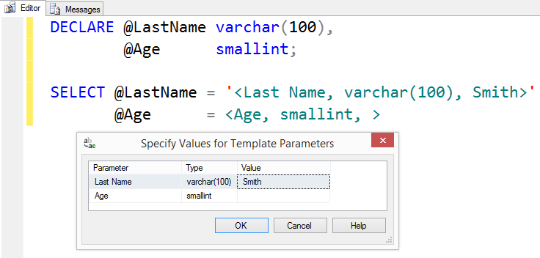
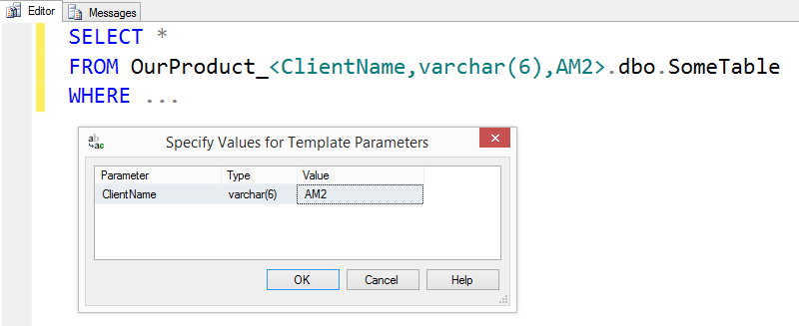
CTRL + SHIFT + M
Template Replacement
Using templates for saved/reusable scripts
<label, datatype, default value>

Slide 9
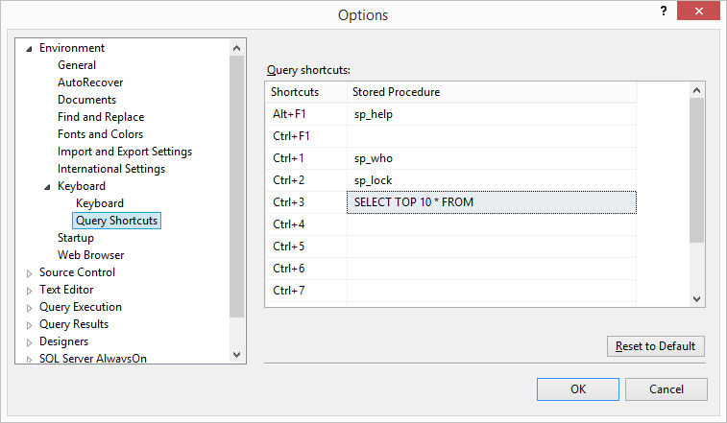
SSMS Query Shortcuts
3 Built-in, non-customizable
9 customizable shortcuts
Get to frequent queries quickly
Highlight text, then use shortcut key combination
SELECT TOP 10 * FROM
Highlight table name, hit Ctrl+3

Slide 10
SSMS Query Shortcuts
3 Built-in, non-customizable
9 customizable shortcuts
Get to frequent queries quickly
Highlight text, then use shortcut key combination
SELECT TOP 10 * FROM
Highlight table name, hit Ctrl+3

Slide 11
ALT + SHIFT + Arrow ALT + DRAG
Block highlighting / vertical highlighting
Easily edit a column of text

Slide 12
SSMS Gestures & Usability

Slide 13
Management Studio Drag
Drag-drop a tab in SSMS to re-order
Drag a tab out of SSMS to float/undock
Also Window→Float from the menu
Chrome, IE/Edge, and other apps with tabbed UIs offer similar behavior

Slide 14
All the columns
Drag “Columns” folder from Object Explorer to list all column names
This doesn’t work with every folder in SSMS

Slide 15
Comment out your comments
More easily comment/uncomment long comments
Use /* to start the comment, and --*/ to end
Comment out the start, and you un-comment the whole thing
No need to hunt for where the comment ends

Slide 16
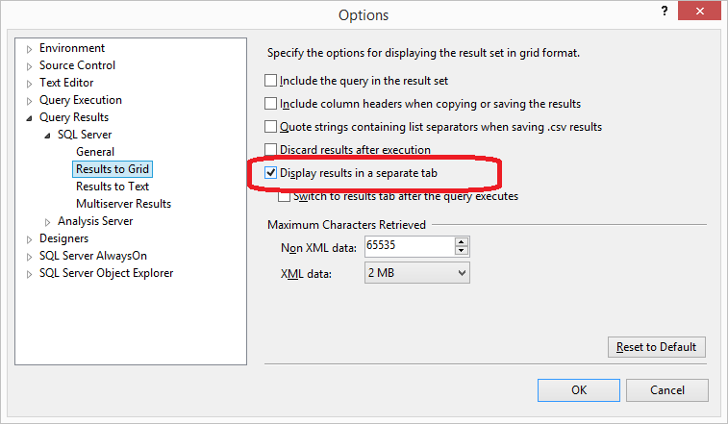
Results as separate tab
Results as separate tab, instead of results pane
F6 to switch between tabs
Ctrl+R to hide the results pane won’t work, because there’s no results pane
Good for when screen real estate matters
Laptop screen
Projector
Long queries
Notes:
You’ll see most presenters using this, but I love it anytime I’m working on my teeny tiny 13” laptop screen.

Slide 17
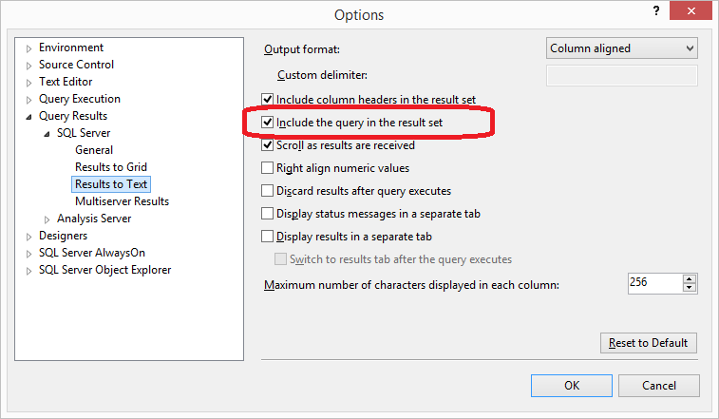
Include query in result set
Makes a quick report that also includes a record of what query you used to generate the results
Auditors love this
“Proves” you didn’t cheat in generating output
One-time ad-hoc queries for end users
Never lose the script you used to generate the output
One-time queries are rarely one-time—they’ll want it again next month or next year
Notes:
Setting is available for both “Results to Grid” and “Results to Text” … With “Results to Text” it will appear on your Results tab. With “Results to Grid” it will appear on the Messages tab.

Slide 18
More tips & details at
http://bit.ly/am2-shortcuts

